Slide 1
Domain Modeling
Team name: Function;Chaos Team members: Zach Goodenow, Paul Trapp, Shun Lin, Alber Moied, Martin Hu

Slide 2
Glossary
1. Player. A person who plays a game by moving pieces.
2. Player Profile. A profile of a player that has the players nickname and records the history of games played.
3. Game. A game of Chad between two players that has a unique ID and is played on a board. A game has a status that describes if the game is ready to play, currently being played, the player whose turn is next, and the player who won.

Slide 3
Glossary (cont.)
4. Board. A 12 by 12 matrix in which a game is played on that contains 144 squares.
5. Square. A spot that a game piece is on or can be moved to with unique coordinates on the board.
6. Piece. An object that players move around the board on squares and is one of the following types:
a. King. A type of piece that can move and capture like a Chess king or Chess knight.
b. Queen. A type of piece that moves like a queen in chess.
c. Rook. A type of piece that moves like a rook in chess, and if ending on a square in the enemy castle, automatically promotes to a queen.

Slide 4
Attributes
Player:
Player ID - This attribute is the specific ID for each player, different from player account.
Email - As a player account, system can invite an unregistered user via email
Password - Each account has a password
Player Profile:
Nickname - A nickname can be show when playing a game (not specific)
Game History - Record of wins, loses, and current games. Takes status from each game played

Slide 5
Attributes (cont.)
Game:
Game ID - Each game has a specific ID to let the system know which game it is
Status - Status will show the game is already to play or not, and when the status is finish, a result will store in players profile
Board:
The Board contains 144 squares
Square:
Coordinate - Will show where each pieces are (Rows, Columns)

Slide 6
Concepts
This domain model does not include methods, operations, or functions
Each line shows the association between conceptual classes
No attributes representing foreign keys

Slide 7
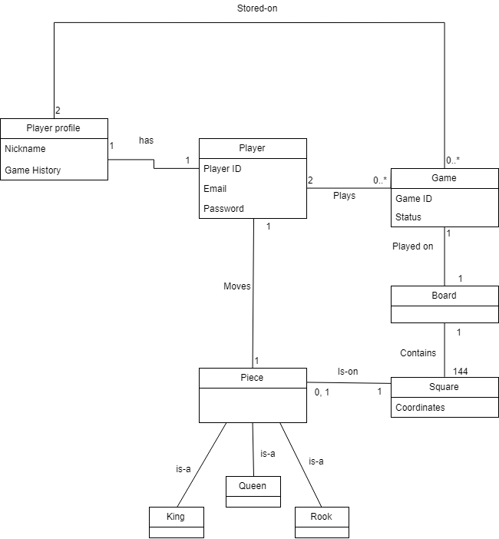
Domain Modeling
Diagram

Slide 8
More attributes?
Player Profile: Gender, Register Date, ……
Game: Gaming Time, Game, Game Holder, Visitors, ......
Piece: Piece (White or Black), Shape, ……
Board: Rows and Columns
Not Necessary!!

Slide 9
Use case updates
General
System failure at anytime results in restart and restore data
Use cases
Changed “Invite player” use case to “Invite registered player”
Added “Invite new player”

Slide 10

Questions?

